Slide 1

WEB APPLICATION TESTING
FACEBOOK

Slide 2
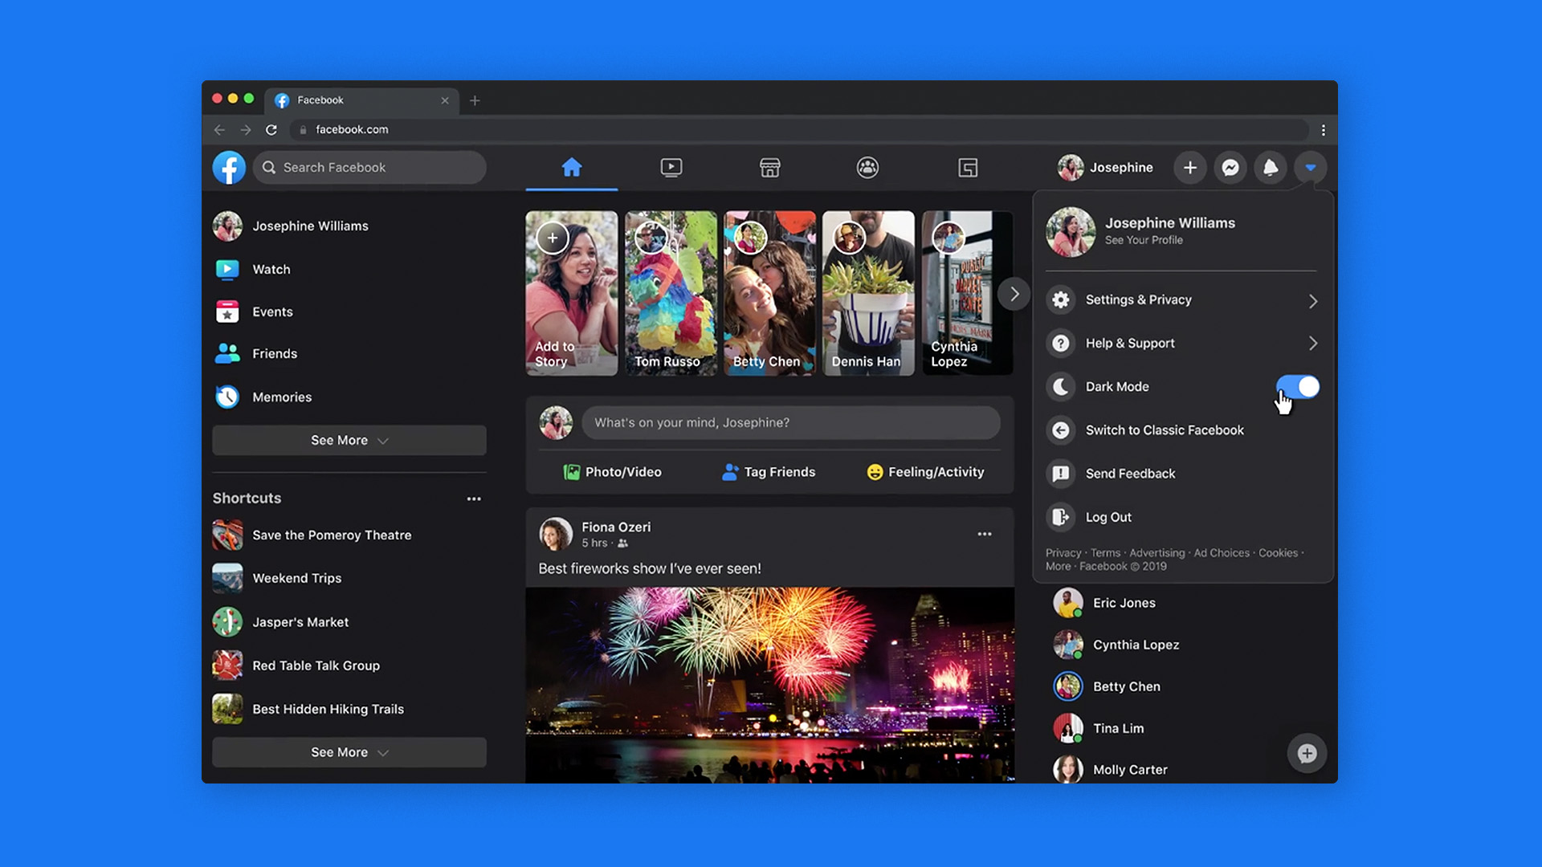
APP DESCRIPTION
Web application
Biggest Social Media platform
Currently has over 10,000 modules

Slide 3


TESTING APPROACH
Other types of testing such as functional, black box or volume testing have also been used
SMOKE TESTS – FOR MOST FEATURES

Slide 4

TESTLINK
MANTIS BUG TRACKER
•Test Case Management
•Bug reporting Tool
SNIPPING TOOL
XMIND TOOL
TOOLS USED
•Lightshot
•Mind Maps

Slide 5

EXPLORATORY TESTING
SMOKE TESTING
FUNCTIONAL TESTING
01
NON-FUNCTIONAL TESTING
TESTING TYPES
VOLUME TESTING
NEGATIVE TESTING
03
03
MONKEY TESTING
GORILLA TESTING
UI TESTING
USABILITY TESTING

Slide 6
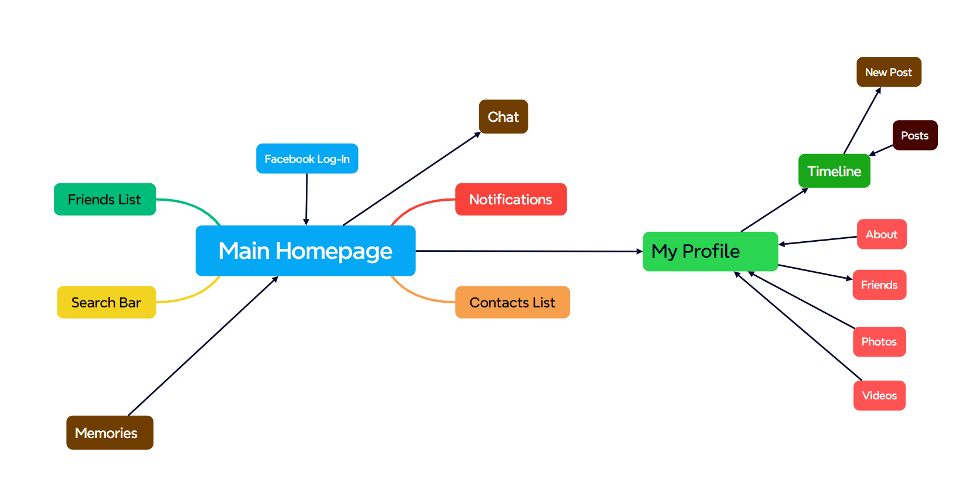

Slide 7
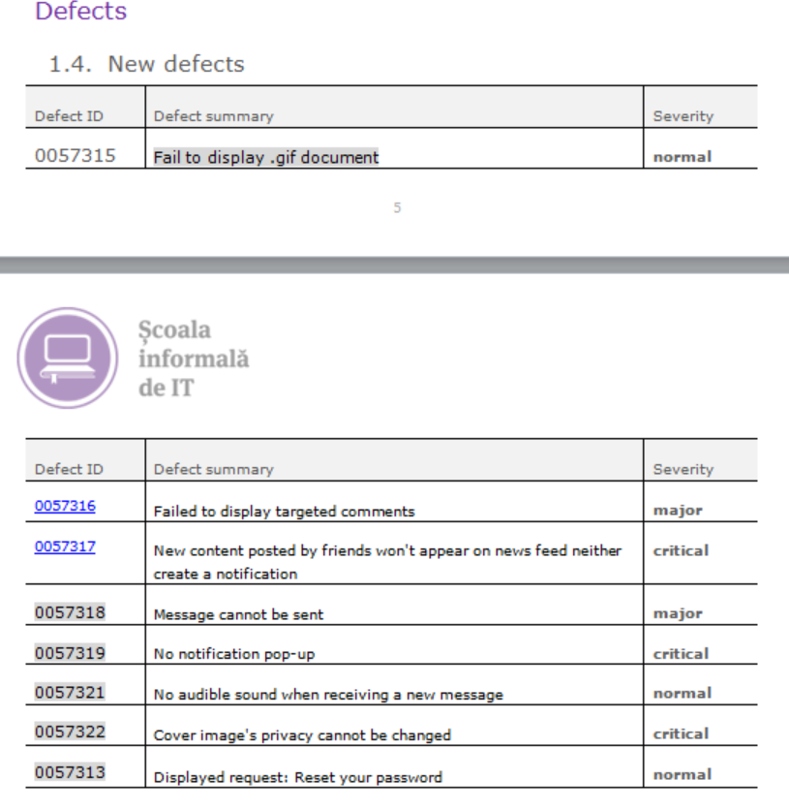
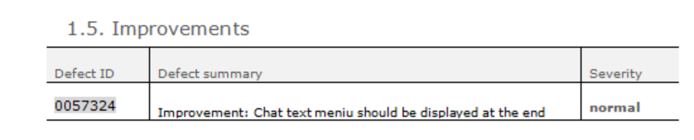
BUGS

Slide 8
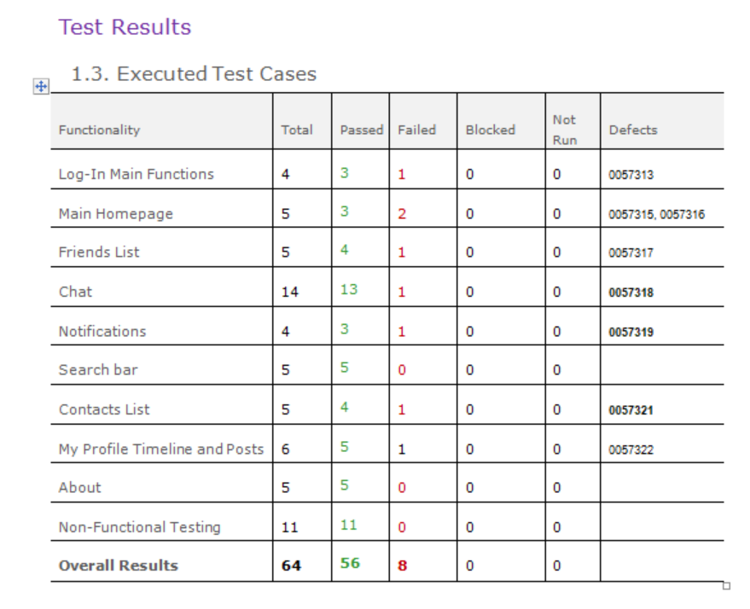
TEST CASES RESULTS

Slide 9

The total number of tests being conducted was 64, out of which 87.5% are passed and the remaining 12.5% are failed. No blocked tests were found.
•A total number of 8 bugs were identified. Most bugs were found using Functional testing.
Out of the 8 bugs, 3 have normal severity, 3 bugs were critical and only 2 bugs were major.
There is 1 improvement and it targets the UI of Chat module, where modifying the menu location would greatly improve accessibility.

Slide 10
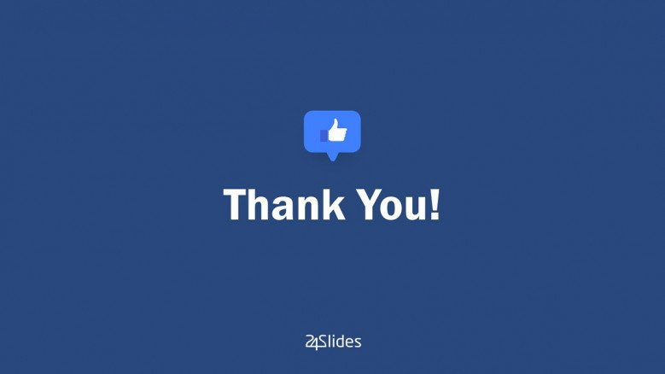

LESSONS LEARNT
GOOD PLANNING PRECEEDS SUCCESFUL RESULTS
Mind mapping & Being familiar with the app made a tremendous difference
TEST AS MUCH AS POSSIBLE
By targeting as many features as possible, finding bugs was guaranteed
THINK LIKE AN END USER
Start small: from unit testing to end-to-end
ALWAYS START WITH MAIN FUNCTIONALITIES
Try to see beyond front-end. Think about back-end too!
UX TESTING IS ESSENTIAL
03

